Slide 1

Arduino programming
BY: Aya Ali Kamal

Slide 2
Agenda
C++ overview.
Micro processors VS micro controllers.
Types of micro controllers.
Arduino:
Hardware.
Software.

Slide 3
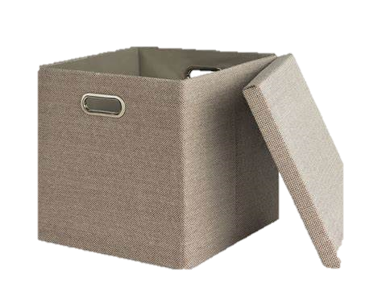
C++ Overview
Constants & variables:
Box.
Constants.
Variable types

Slide 4
C++ Overview
Constants & variables:
constants.
Variable types
Floats
Int
Double
String
Char
Byte
Bool
Uint8
Uint16

Slide 5
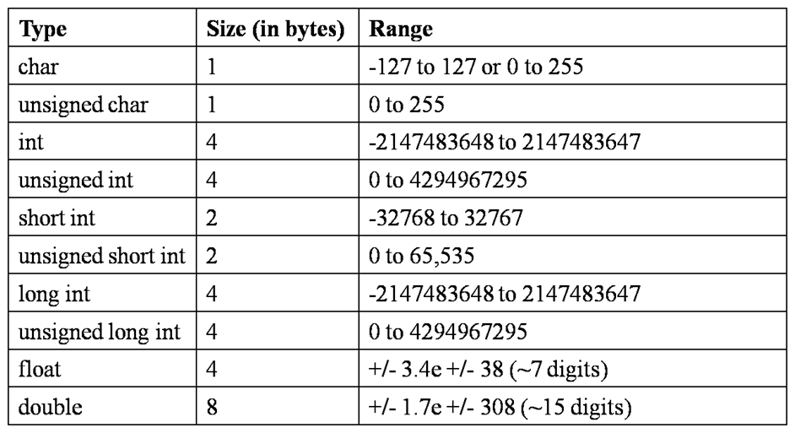


Variables size:

Slide 6
C++ Overview
#include:
Wanting to include file.
#include < Arduino.h>.
#include “Arduino.h”.

Slide 7
C++ Overview
# define:
Definition.
Used to define constants or pin.

Slide 8

C++ Overview
If condition:
Taking decision.
If.
else if.
else.

Slide 9
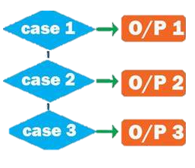
C++ Overview
Switch case:
Making decision.

Slide 10

C++ Overview
Loops:
Repeating
While.
do while.
for.

Slide 11

C++ Overview
Function:
Do some thing
Return.
Void.

Slide 12

C++ Overview
Return:
Return something.

Slide 13

C++ Overview
Array:
Collection of variables.
Constant size.

Slide 14
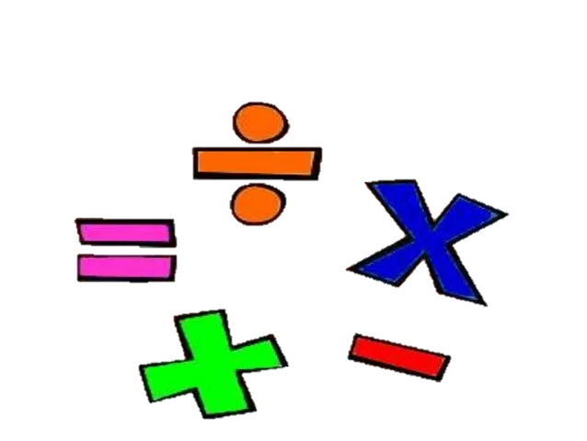
C++ Overview
Operators:
Operations.

Slide 15
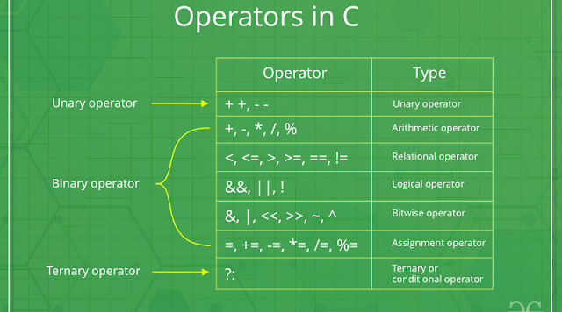

Slide 16
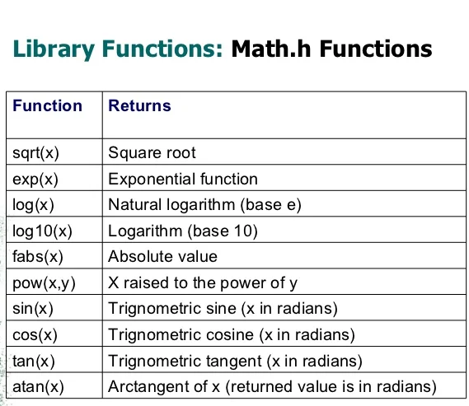
C++ overview:
Math.h
Arduino.
cmath
C++.

Slide 17

C++ Overview
Pointers:
Point on something.
pass by address.

Slide 18

C++ Overview
Struct:
Custom array.
Can contain different data types.

Slide 19
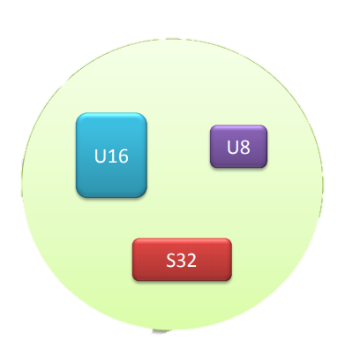

Slide 20


Slide 21
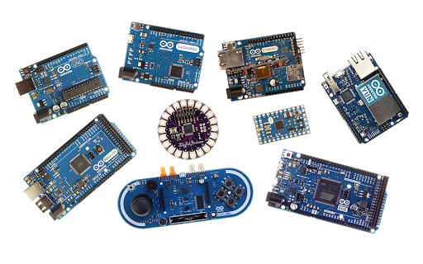
Micro controller:
Arduino types:

Slide 22
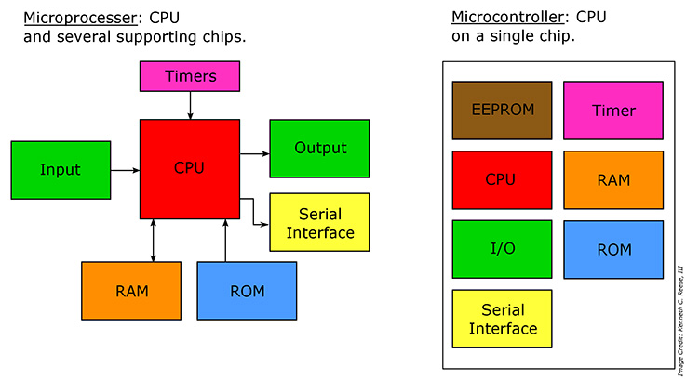
Micro processor VS Micro controller

Slide 23
Arduino Hardware

Slide 24
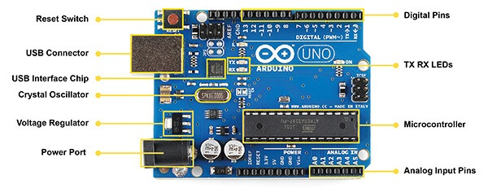

Slide 25
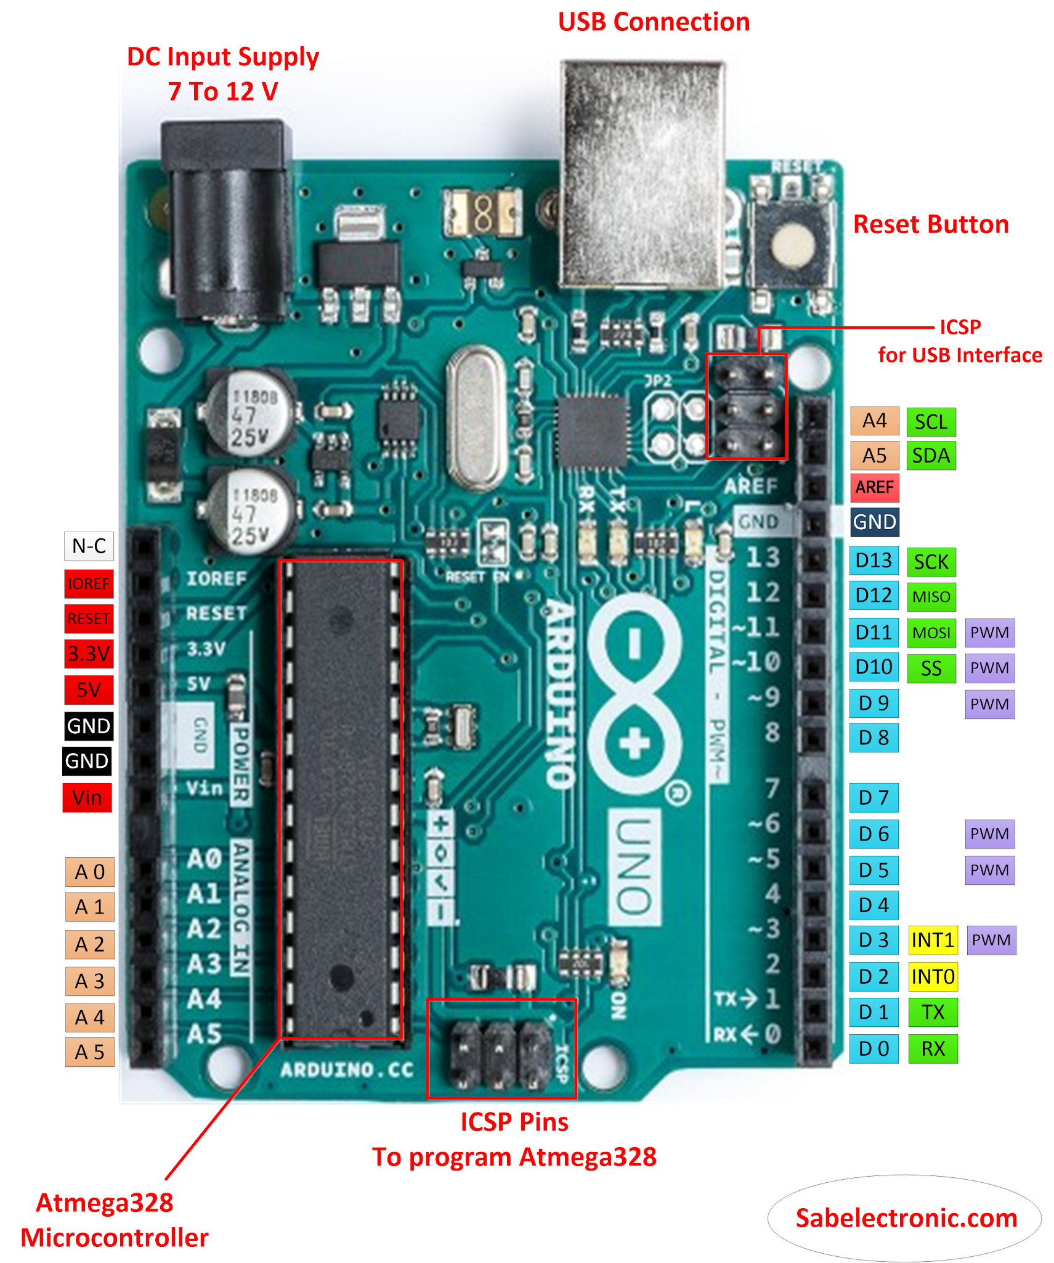
Arduino Pins:

Slide 26
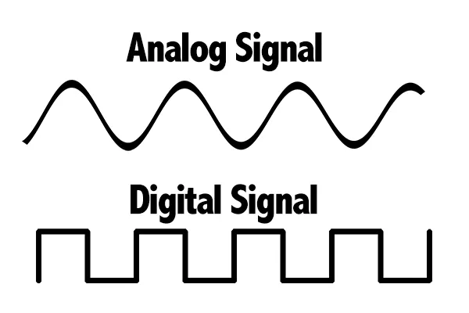
Analog VS digital

Slide 27
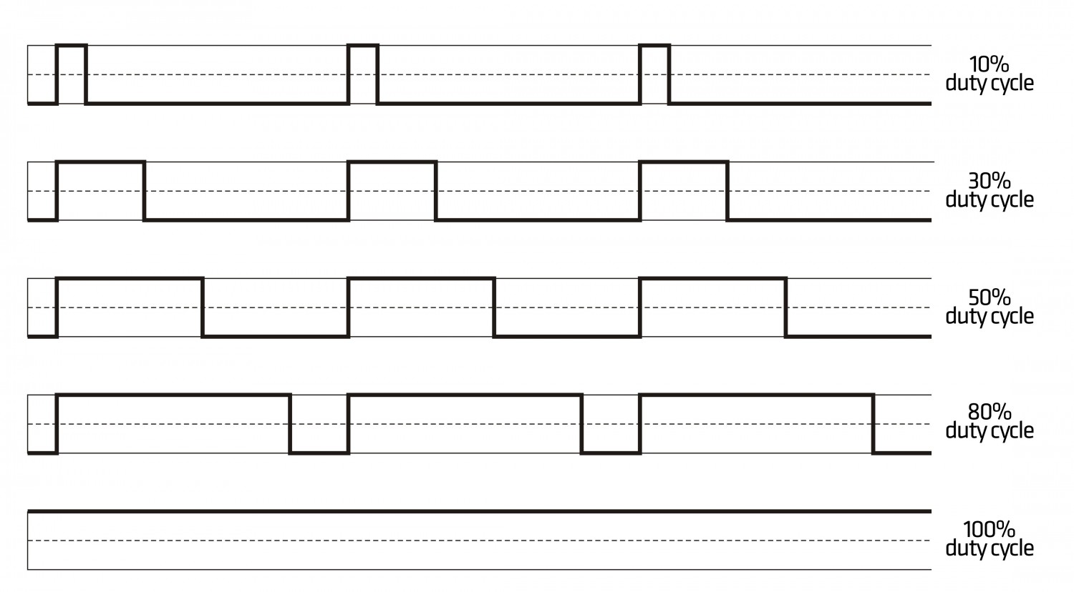
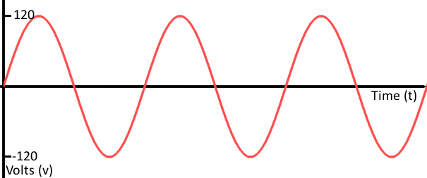
PWM VS Analog

Slide 28
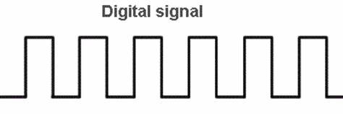
PWM VS digital

Slide 29
Arduino Software
Arduino IDE.
Code implementation.
Void setup.
Void loop.

Slide 30
Arduino Functions:
Hint:
digital Write (), digital Read (), pin Mode ().
Example 1:
Toggling a led using push button.

Slide 31


Slide 32
Examples:
Functions:
analog Read (), map (), analog Write (), pin Mode ().
Example 2:
Control a light density of a led using potentiometer.

Slide 33
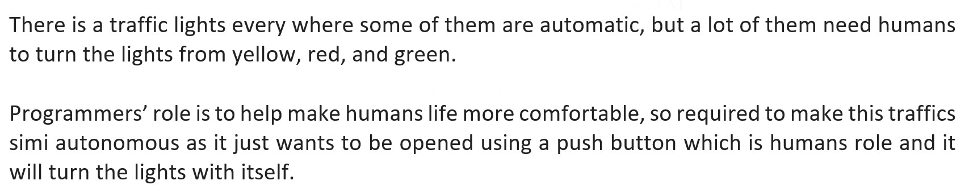
Example 3:

Slide 34
Example 3:
Hint:
Use the following functions.
digital Read(), delay (),digital Write(), pin Mode().

Slide 35
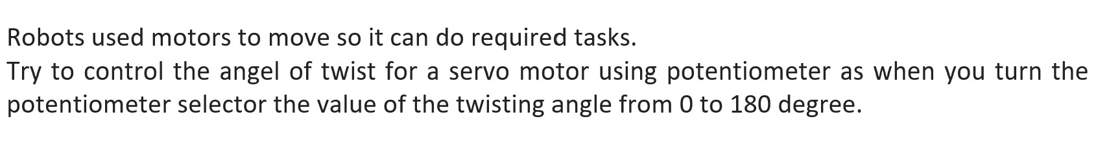
Example 4:

Slide 36
Example 4:
Hint:
Use the following functions.
analog Read (), map(), servo library (servo. attach (), servo. write ()).

Slide 37
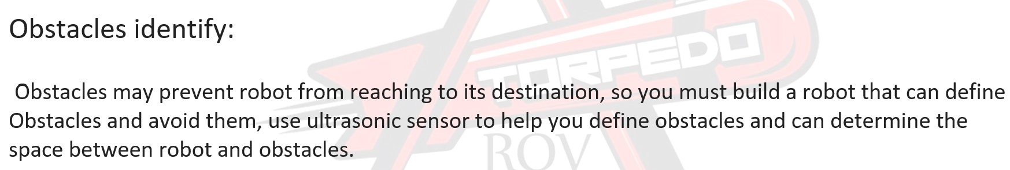
Example 5:

Slide 38
Example 5:
Hint:
Use the following functions: pinMode(), delayMicroseconds(), digitalWrite().

Slide 39


Slide 40


